Slide 1

The Art & Science of Collective Impact:
Insider perspectives on the good, the bad & the ugly in the pursuit of common good
KNOWLEDGE SHARING & TRAINING SERIES
AUGUST 18, 2017

Slide 2
Today’s Training & Sharing
OBJECTIVES:
For EAC leaders to learn about collective impact as a approach to societal change
For EAC leaders to be equipped to begin designing a collective impact initiative
For EAC leaders to short-list the domain(s) in which they may practice collective impact
For UMA to learn more about EAC and its landscape of change, in order to support EAC’s capacity-building for collective impact
PART 1: Collective Impact 101–Basics of the Burgeoning Approach
9 TO 10:30 am
PART 2: Ideal Elements in the Design of Community & Regional Collective Impact
10:40 am to 12:30 pm
PART 3: Sharing the EAC Journey
WORKING LUNCH 12:45 to 2:00 pm
PART 4: Essential Soft Skills for Collective Impact Leaders [8 examples]
2:15 to 3:45 pm

Slide 3
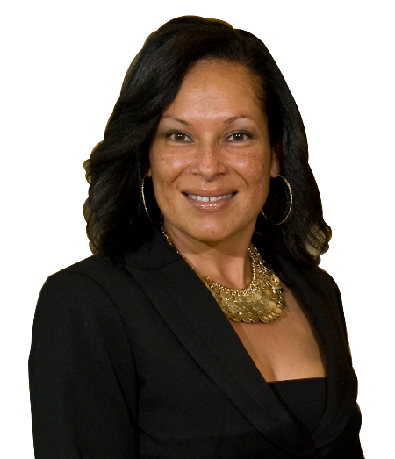
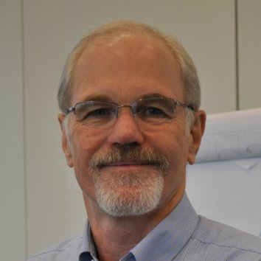



Today’s Trainers & Facilitator
Gypsy C. Gallardo
CEO of The 2020 Plan; CEO of Urban Market Analytics; 12-year collective impact practitioner
Dan Duncan
Senior Consultant, Clear Impact; faculty, ABC Development Institute, Northwestern Univ.
Gwendolyn Reese
President & CEO, Peaten Reese Peaten Consulting & Co-founder of The PACT

Slide 4
Part 1
Collective Impact 101
Basics of the Fast-Rising Approach
What collective impact is and how it differs from collaboration and isolated impact
Live examples of collective impact
5 conditions of collective impact
National players in collective impact

Slide 5



Simple, Complicated & Complex Problems
SIMPLE | COMPLICATED | COMPLEX
Baking a Cake | Sending Rocket to Moon | Raising a Child
The recipe is essential | Rigid protocols or formulas are needed | Rigid protocols have a limited application or are counter-productive
Recipes are tested to assure easy application | Sending 1 rocket increases the likelihood that the next will also be a success | Raising one child provides experience but is no guarantee of success with the next
No particular expertise is required, but The best recipes get good results every time | High levels of expertise and training High degree of certainty of outcome | Expertise helps but only when balanced Uncertainty of outcome remains
A good recipe notes the quantity and nature of “parts” needed and specifies the order in which to combine them, but there is room for experimentation | Success depends on a blueprint that directs development of separate parts and specifies the exact relationship in which to assemble them | Can’t separate the parts from the whole; essence exits in the relationship between different people, different experiences, different moments in time
Source: “Getting to Maybe: How the World Is Changed” Frances Westley, Brenda Zimmerman, Michael Patton

Slide 6
Traditional Approaches Are Not Solving Our Toughest, Most Complex Challenges
Funders select individual grantees
Organizations work separately and compete
Evaluation attempts to isolate a particular organization’s impact
Large scale change is often assumed to depend on scaling organizations
Corporate and government sectors are often disconnected from foundations and nonprofits
Isolated
Impact

Slide 7
Collective Impact – Multiple Players Working Together to Solve Complex Issues
All working toward the same goal and measuring the same things
Cross-sector alignment with government, nonprofit, philanthropic and corporate sectors as partners
Organizations actively coordinating their action and sharing lessons learned
Neighborhoods and their residents engaged as coproducers
Collective Impact

Slide 8
Why Collective Impact: Many Factors Contribute to Pressing Community Issues
Economic conditions
Historical trends
Implicit & Explicit Racism
Media messages
Public sector practices
Health care system practices
Community Issue
Private sector practices
Educational system practices
Neighborhood conditions
System relationships
Most Direct-service Programs Address Only One or Two Factors
Personal choices
Family characteristics
Notes:
Many factors contribute to these and other pressing issues in our communities.
These issues have developed because of economic conditions; historical trends; public and private sector practices; disconnections among community systems; and a host of other community conditions.

Slide 9
Lisbeth Schorr: Lessons on What Works
Suggests five lessons:
Be clear about the purposes of our work, the outcomes we are trying to achieve
Be willing to be held accountable for achieving those purposes
Create and sustain the partnerships to achieve these purposes
Move audaciously into the world beyond programs
Have the capacity to take community-wide responsibility to assure that actions that will lead to improved lives will actually happen
Predecessors to the Collective Impact Movement
Source: Lisbeth Schorr Keynote Address, Santa Clara County Children’s Summit – January 31, 2008

Slide 10

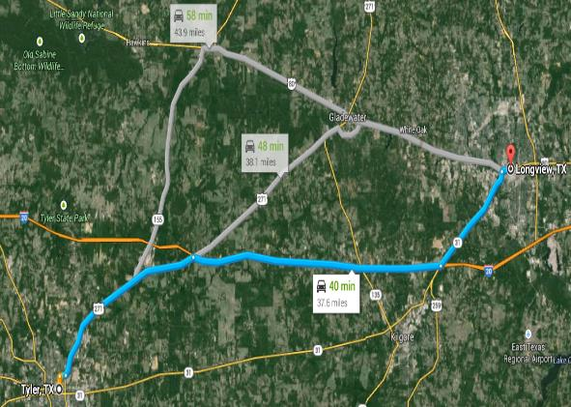
A Compass Instead of a Map
Oriented to the ultimate goal
Oriented to following a certain path
(Logic Model)
Kania, Kramer & Russell. Strategic Philanthropy for a Complex World. Stanford Social Innovation Review. Summer 2014

Slide 11
5 Conditions of Collective Impact
Common Agenda
Common understanding of the complex problem
Shared vision for change
Collecting data and measuring results
Focus on learning and performance management
Shared accountably
Shared Measurement
Multiple Reinforcing Activities
Willingness to adapt individual activities and coordinate
Focus on what works including community engagement
Continuous Communication
Consistent and open communication
Focus on building trust
Backbone Support
Separate organization(s) with staff
Resources and skills to convene and coordinate the work of the partners and the community
John Kania & Mark Krame

Slide 12
Collaboration vs Collective Impact
There is consensus and controversy about the differences between collaboration vs collective impact; the field continues to strengthen through proofs and challenges.
Collaboration | Collective Impact
Programs Focus | Outcomes Focus
Data Used to Prove | Data used to Improve (Disaggregated; Pin Pointed)
Do More | Work Better
Importing Ideas (often) | Engaging Community

Slide 13
Live Examples of Collective Impact
■ The Road Map Project focuses on doubling the number of students on track to graduate with a postsecondary degree or credential in the urban South Seattle region by 2020.
■ RE-AMP Energy Network, 125 nonprofits and funders across 8 states in upper Midwest focused on reducing regional global warming emissions 80% (from 2005 levels) by 2050.
■ Farm to Plate, self-governing network collaborative approach to 25 goals to transform Vermont’s food system
■ StriveTogether, begun 2006 as partnership of 300 orgs in Cincinnati & Northern KY to improve education; improvements tracked in 40 of its 53 measured outcomes, including an 11% increase in high school graduation rates and a 10% increase in college enrollment
■ The 2020 Plan (St. Petersburg, FL), is supported by a network of 100+ partners working together toward the goal of reducing the poverty rate by 30% by the year 2020 in a 25-square mile community known as South St. Petersburg.

Slide 14




National Players & Leaders in the Field
Collective impact is a fast growing field of practice with clear national leaders emerging; and penetration within many traditional fields and funding domains.

Slide 15
Part 2
Ideal Elements for Community-Driven Collective Impact Initiatives
Place-based: Geographically bound enough to see and feel the energy and impact
Time-bound: Infusing the effort with purpose, time-sensitivity and – if possible - urgency
Targeting big goal: Big enough to excite and stretch capacity & realistic enough to achieve
Led by pure backbone group: Minimizing detractions inherent in other organization types
Designed to evolve, not solve: Avoiding trap of trying to change too much, too fast
Hyper-focused on hitting numbers: Avoid energy drains; above all, keep eyes on the prize!

Slide 16
The 2020 Plan was born as a collective impact initiative to reduce poverty by 30% by 2020 in South St. Petersburg
Economic Dev.
Business Dev.
Florida’s largest poverty-reduction plan
The only one with a specific target for poverty reduction
The only one created and led by the community
2020 is a pure “backbone” organization backed by 100+ partners
Workforce Dev.
Family Wrap-Around

Slide 17


Formula to Accelerate Poverty Reduction
FOCUS: Help 2,000 “working poor and willing” parents to lift themselves and their children above poverty line.
ON THE SYSTEMS LEVEL:
Accelerate business growth & job creation
ON A PERSONAL LEVEL:
Offer parents and others wrap-around support to start and complete a journey to exit poverty
Bridging more people into the workforce and up the career ladder

Slide 18
Some of our Impact (so far)
6-year advocacy campaign that resulted in creation of South St. Petersburg CRA (historic on multiple counts)
“Working 1000” Youth Employment push that’s generated record-setting levels of youth employment
$10 Million Capital Quest that’s closed the capital gap for micro & small business debt and equity, for now…..and we continue to raise
10-fold growth in no. of programs helping families exit poverty since our first pilot at the Urban League in 2014, thanks to the Pinellas Opportunity Council and other partners

Slide 19
Impact E.g. 1:
Business formation outstripping rest of city, esp. in CRA
Impact E.g. 2:
Youth employment doubled over prior decade average

Slide 20
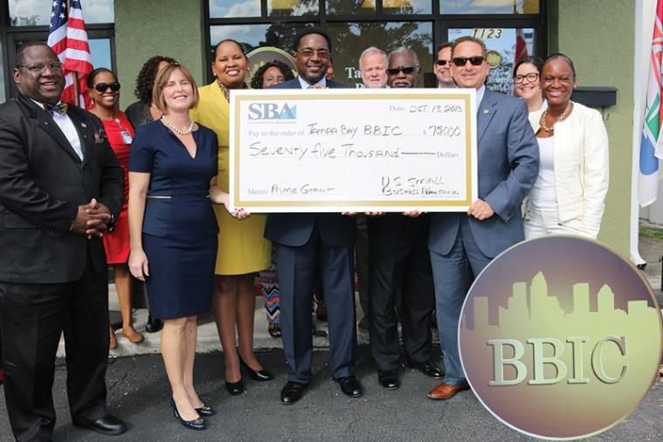
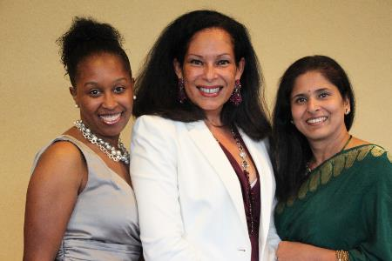
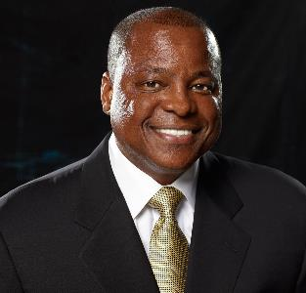
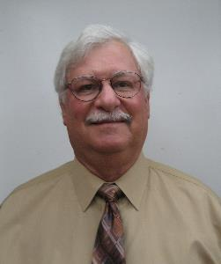

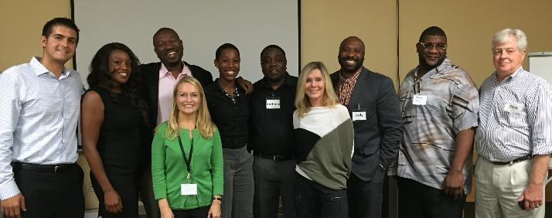
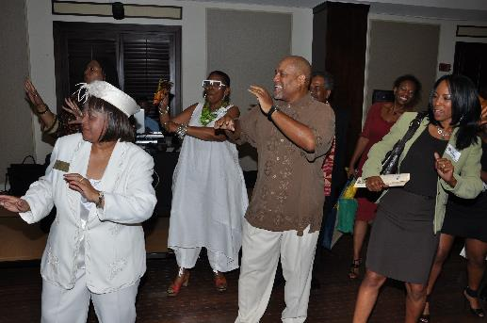
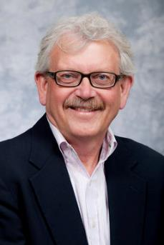
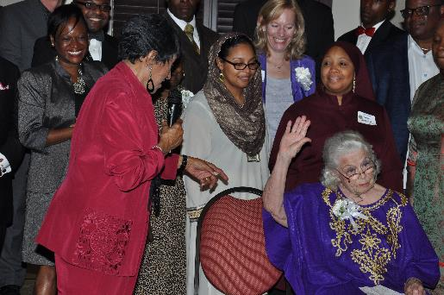
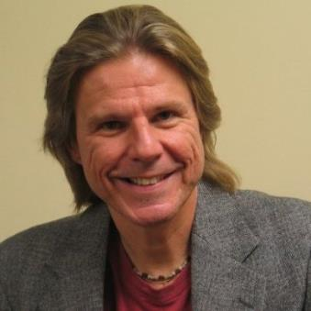
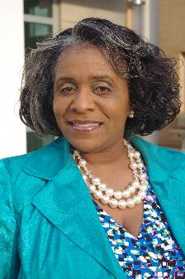
MVPs for Impact to 2020 goals
MVPs for Impact to 2020 goals

Slide 21
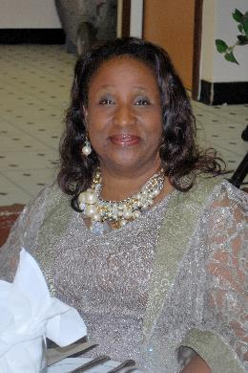
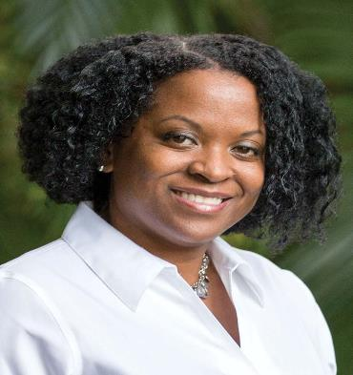

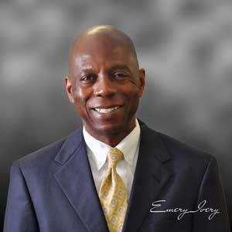
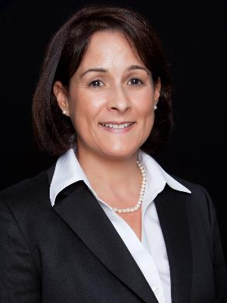
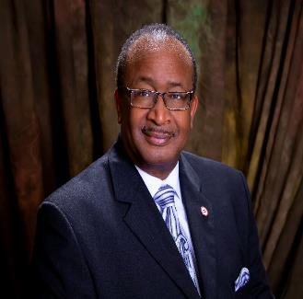
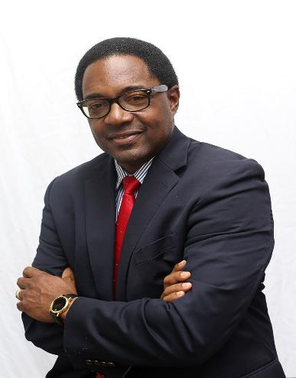
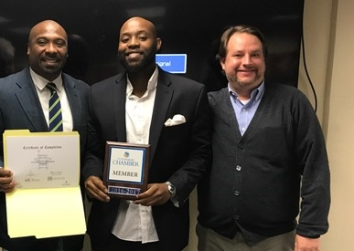
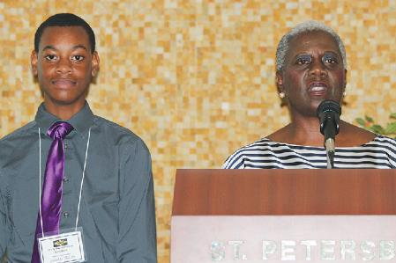
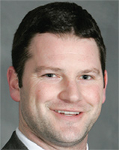
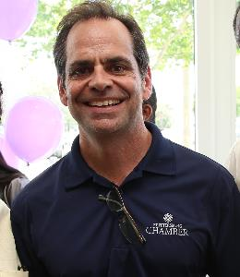

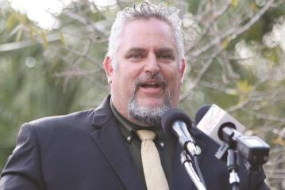
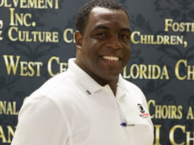

MVPs for Impact to 2020 goals

Slide 22
Knowledge Sharing with 2020 Plan Collective Impact Leaders
Please prepare your questions!

Slide 23
Part 3
Sharing the EAC Journey
This interactive dialogue session will be led by EAC leaders who will share the origins of the EAC and the vision of founding leaders

Slide 24
Part 4
Essential Soft Skills for Collective Impact Leaders [8 examples]
Stand as an equal among alphas & A-types
Fade to black as easily as they rise to the fore
Weave win-wins
Cut to the chase, without cutting to the bone
Follow the leaders who get things done
Sense the way of the wind, seize opportunities
Roll with the punches
Above all–keep eyes on the prize!

Slide 25
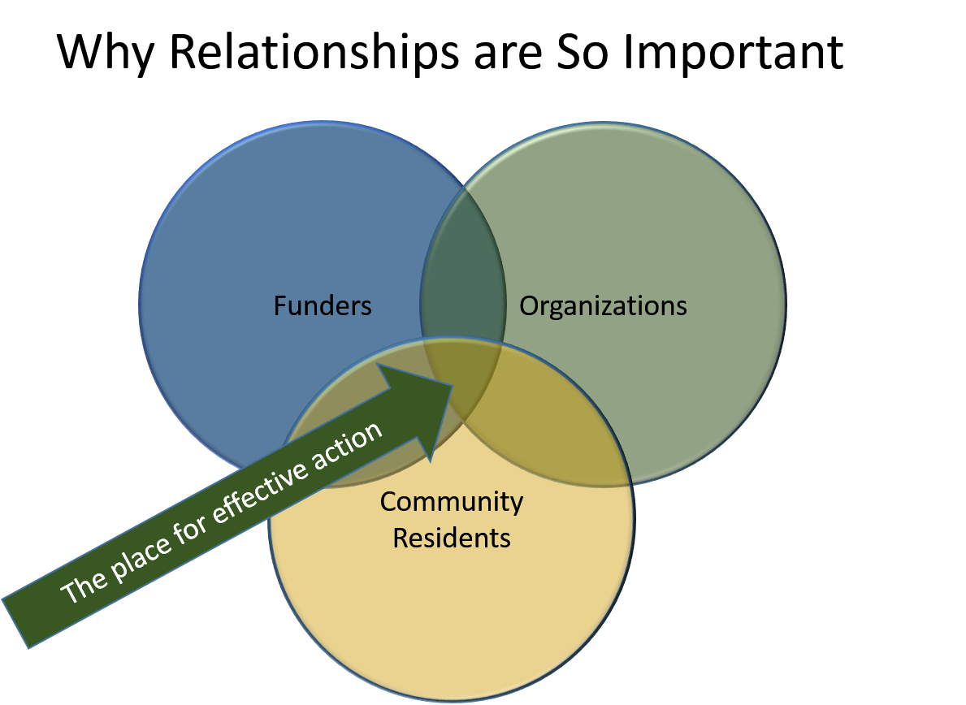
Critical Role of Relationships & Trusts
Effective Collective Impact
Equity, Inclusion, and Social Justice
Common Purpose
Relationships & Trust
Community Engagement & Coproduction
Results & Accountability

Slide 26
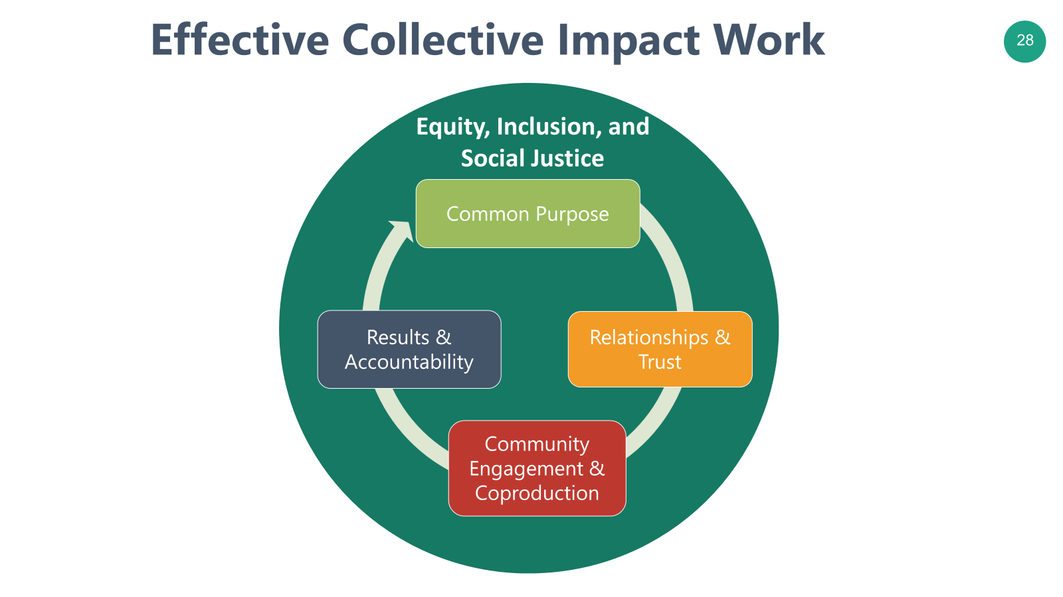

Slide 27
Collective Impact–Effective Partnerships
Organizations do not work together–People Do
Change happens at the speed of trust
Partnerships reset to zero when key people change
Key role of the Backbone Organization - Focus on building relationships and trust

Slide 28
Circles of Care, Responsibilities
& Relationships
Government
Organizations
Social Media
Faith Based
Effective Place-Based Strategies Engage all of the Circles
Friends
Family
Individual
Neighbors
Associations
Communities of Interest
Helping Professionals

Slide 29

Co-production
“An approach to problem-solving where citizens and professionals share power and work together in equal partnership. Co-production values all participants as equals and is built around people, not around systems. Instead of fitting citizens into existing services, professionals work with citizens to figure out solutions to problems that matter to them and could not could not have been achieved without both parties.”

Slide 30
Where Do We Go From Here?
Thoughts? Questions? Next Steps?

